Slide 1
Nuclear Magnetic Resonance
By Arman Rasheed and Vishnu Nair

Slide 2
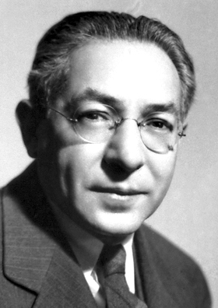
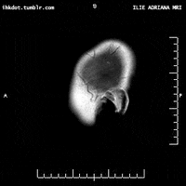
Historical Significance
Discovered in 1938 by Physicist Isidor Rabi who received a Nobel Prize for his work
In 1974, Physicists Peter Mansfield and Paul Lauterbur used NMR to generate images of animal organs
This laid the foundation for MRI technology to be engineered
Applications also found in analytical chemistry (C13 NMR), any non-destructive testing, and even Quantum Computing!

Slide 3
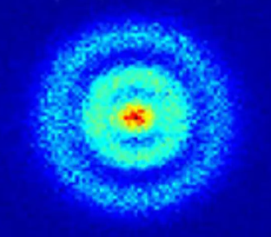
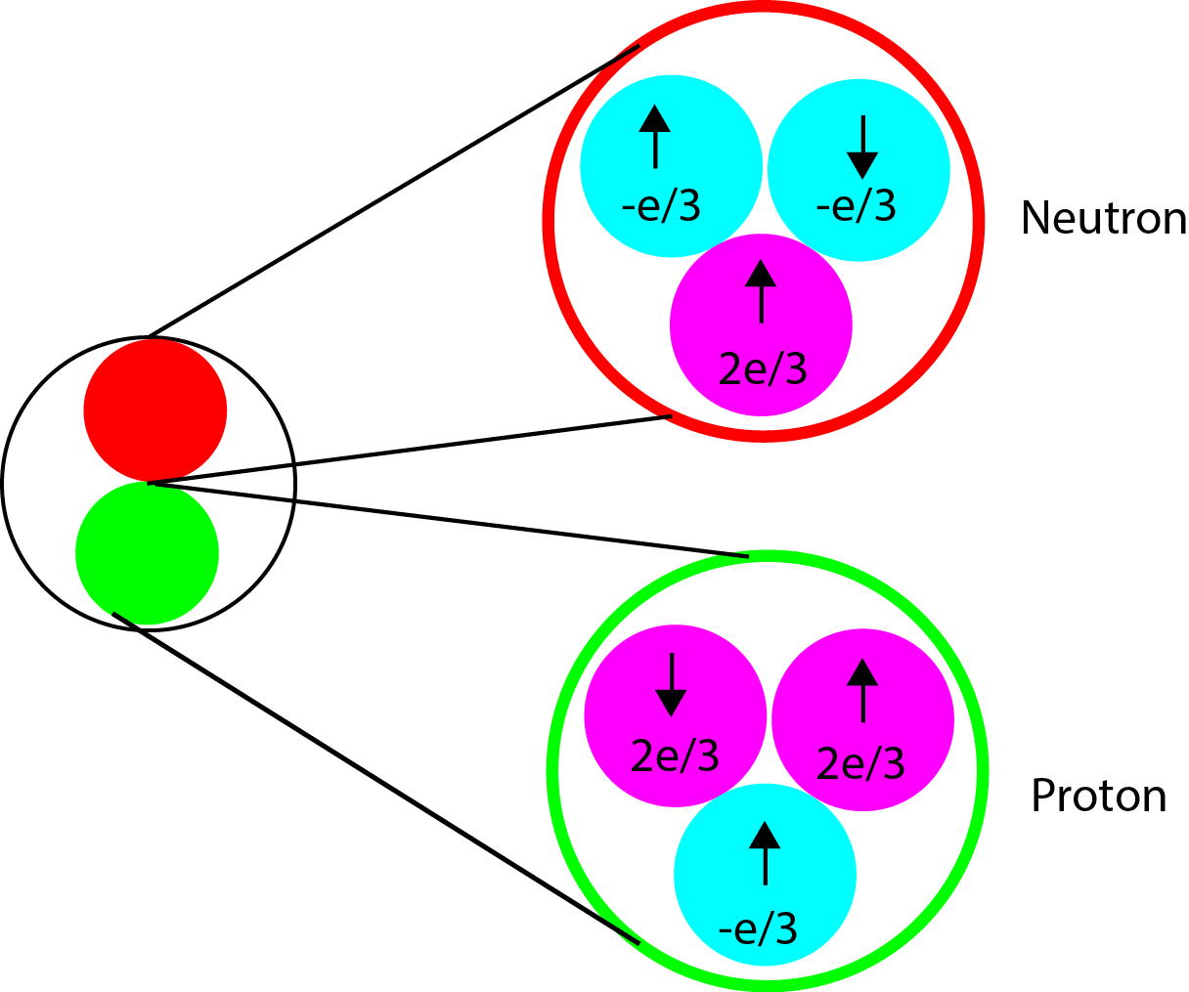
Introduction
All matter is made up of atoms (except maybe Dark matter idk)
All atoms have a nucleus at their center.
The protons and neutrons within the nucleus may have a small magnetic moment (Nuclear Spin)

Slide 4
Nuclear Magnetic Resonance
Sample can be put into a constant magnetic field (CMF) which causes sample’s nuclear spin to be in the same direction
An oscillating magnetic field can be introduced perpendicular to the CMF
This field causes the nuclear spin of the sample to rotate until it reaches an observable resonant frequency
The spin of the sample can be relaxed and the time it takes to return to the CMF direction can be measured

Slide 5
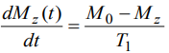
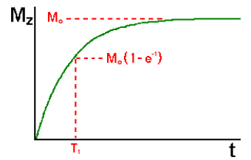
Relevant Math
Differential Equation which governs the initial magnetization of a sample placed into a constant magnetic field.
T1 is the significant variable here = Spin-Lattice Relaxation Time
Graph shows the solution to this equation
Depicts the time it takes for a sample’s magnetic field to orientate in the direction of the applied magnetic field.

Slide 6
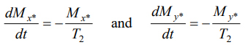
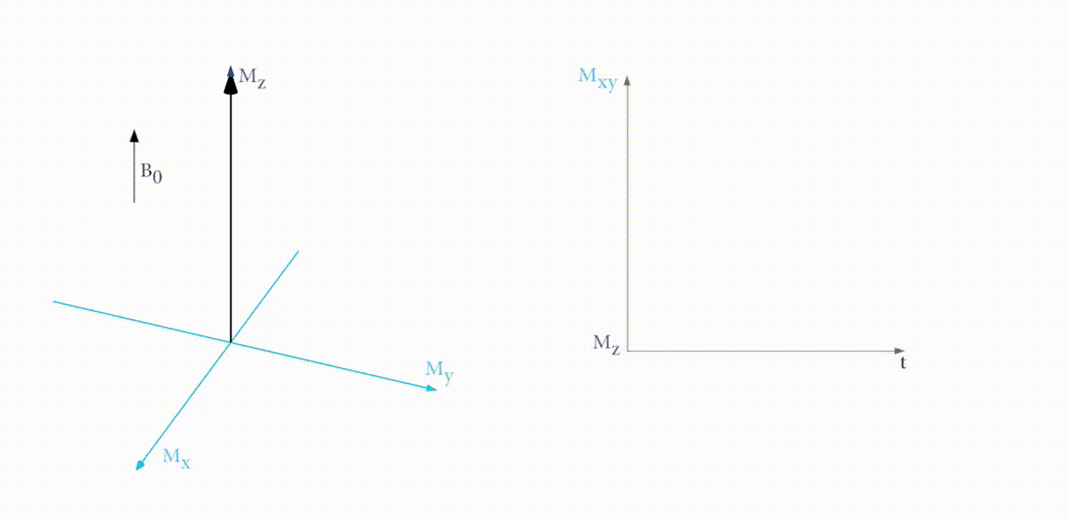
More Math
Differential Equations which describe decay in the XY coordinate plane from resonance
T2 = Spin-Spin Relaxation Time

Slide 7
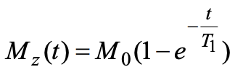
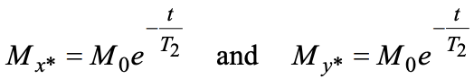
Spin-Lattice Relaxation and Spin-Spin Relaxation
Spin-Lattice Relaxation
Represented as T1
Rate at which the the Mz component of the sample magnetic vector recovers towards the initial magnetic field direction
Spin-Spin Relaxation
Represented as T2
Time it takes for the x & y components of magnetism to decay leaving only the magnetic vector in the z-direction

Slide 8
Posed Question
How can NMR be experimentally observed and what are its properties?

Slide 9
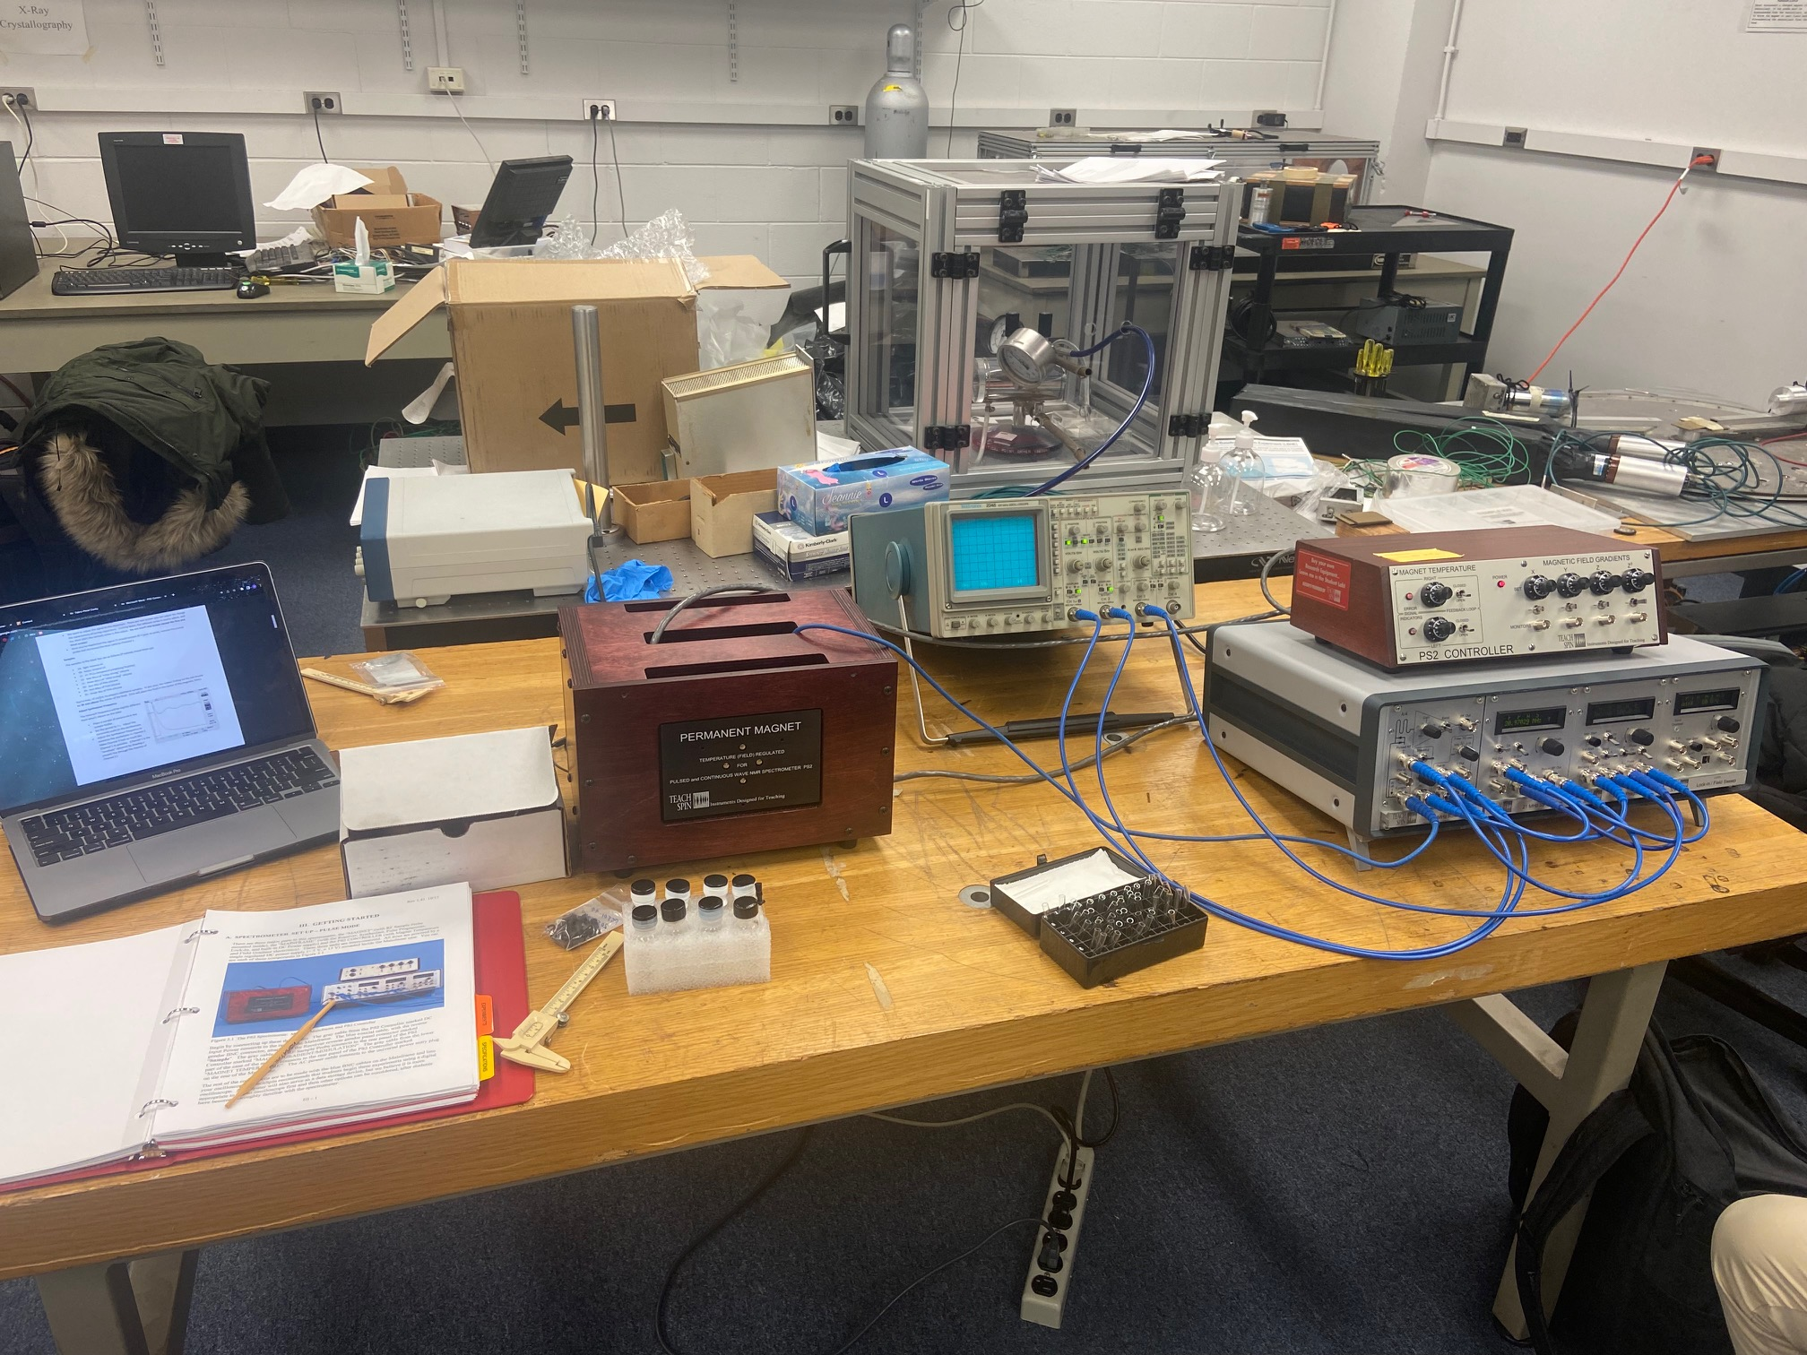
Experimental Description
The experimental module consists of 4 separate components being used which is the magnet, the oscilloscope, the PS2 controller, and the pulse programmer.
The mineral oil sample is placed into the magnet, with the oscilloscope being connected to the pulse programmer.
The PS2 controller is adjusted for each direction for least interference.
The pulse programmer is also set for specific configurations on the receiver, synthesizer and pulse sections.
The mineral oil sample was used for each trial and by adjusting the pulse programmer, we were able to produce multiple waveforms.
This then allows us to calculate the relaxation times, T₁ and T₂.

Slide 10
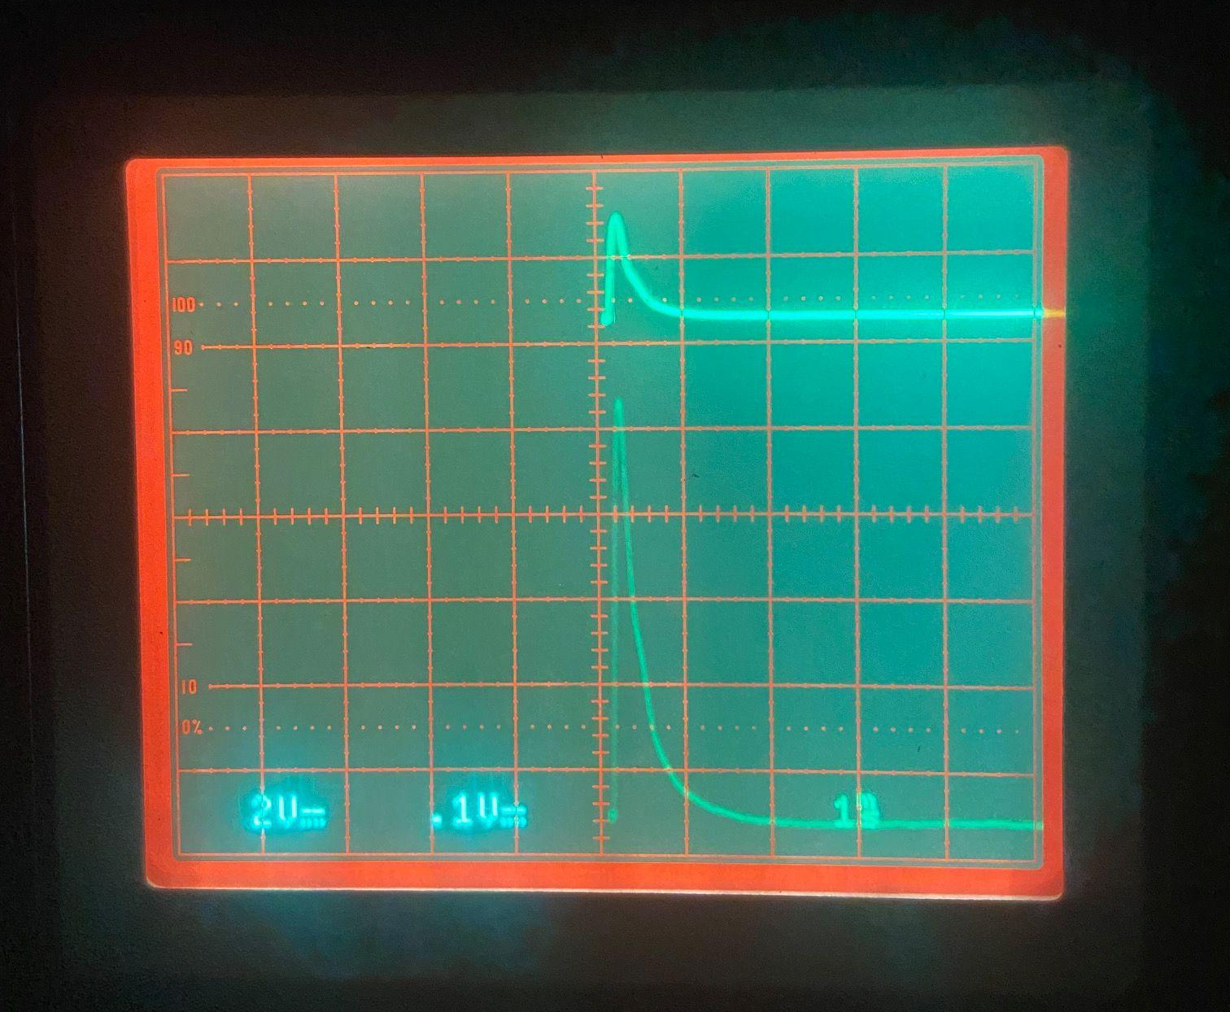
Results and Analysis
Before we conducted the experiment, we established resonance between the two waveforms.
This was achieved by aligning the waves so that their initial peak are in the same vertical position.
The divisions for the waveforms are 2V and 0.1V for the top and bottom waveforms, respectively.
The top waveform represents the pickup probe frequency and the bottom waveform is the synthesizer frequency.

Slide 11
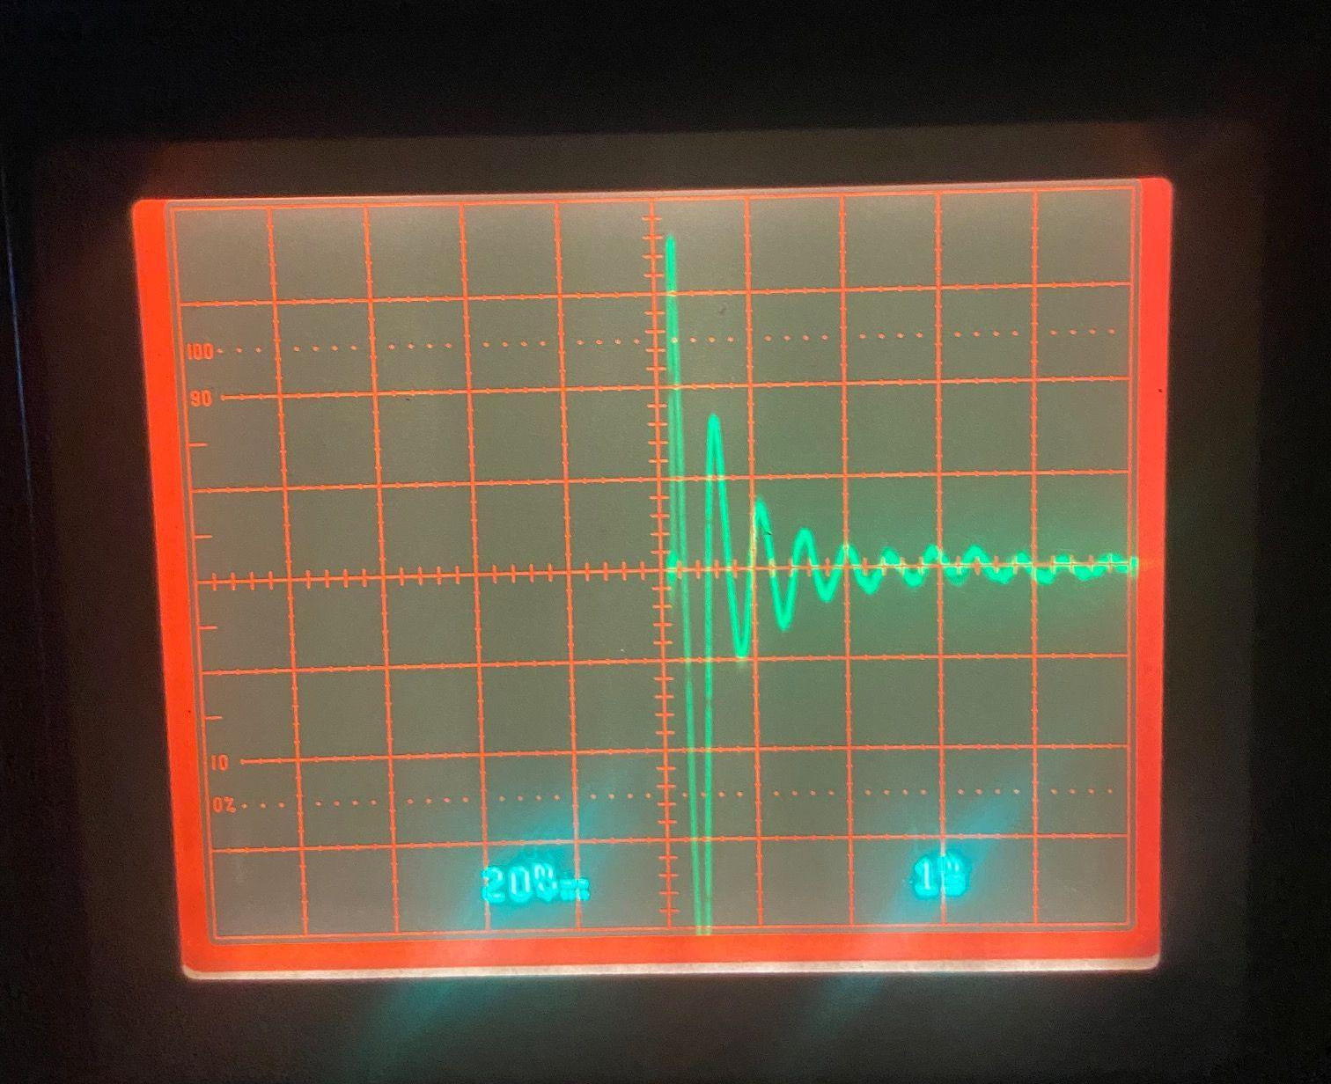
Results and Analysis Cont.
Within this waveform, we observe the phenomenon known as Free-Induction Decay(FID).
FID is the term used to describe the signal produced when a 90º pulse, representing an unaligned spin magnetization, is projected onto an external magnetic field.
The waveform shows the spins of the nuclei dephasing over time with respect to a decay constant.
This decay constant gives us the T₁ relaxation time.

Slide 12
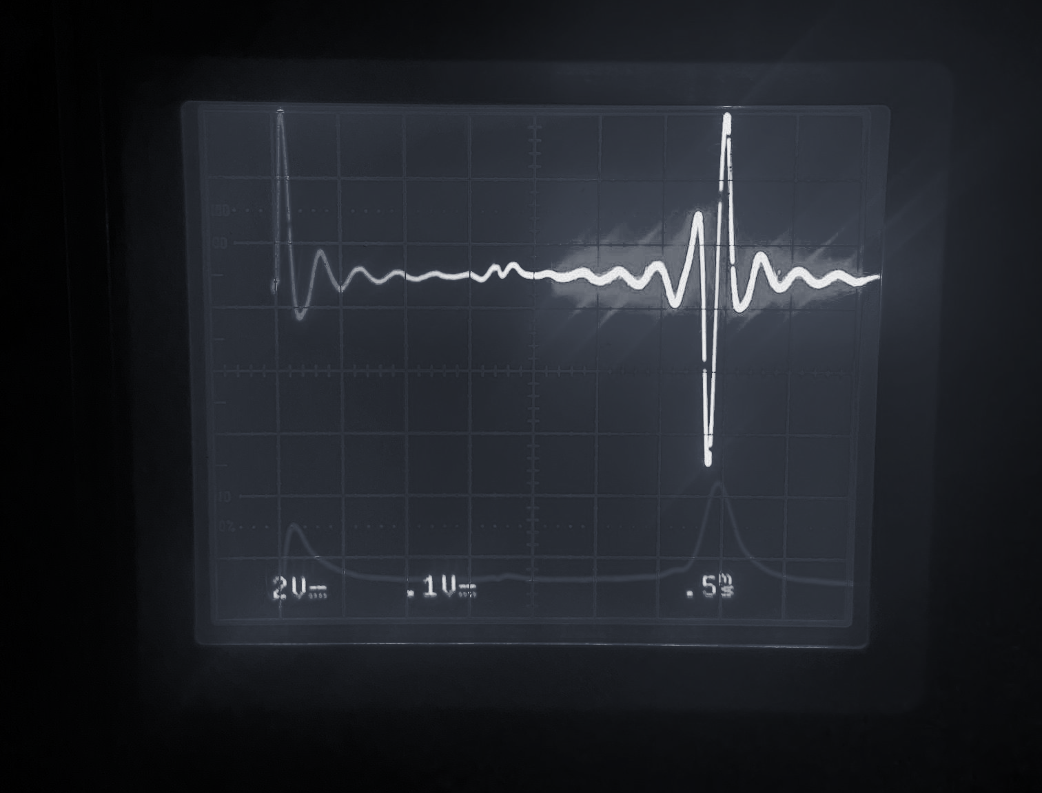
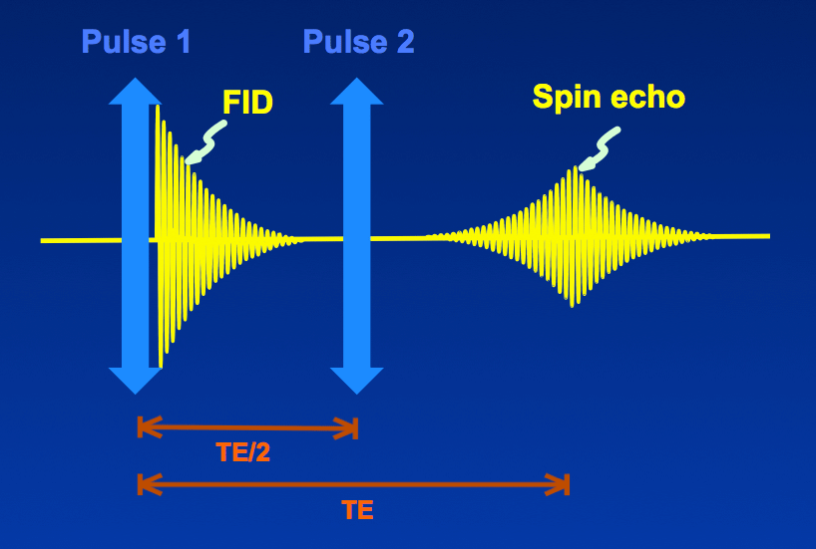
Results and Analysis Cont.
Within these waveforms, we observed the phenomenon called a spin echo.
This “echo” is the second signal produced after the initial 90º pulse, which in turn is produced by a 180º pulse.
This reversal of spin direction causes slower spins to be ahead of the faster spins and where they converge is the spin echo.
Due to the spins interacting with each other, there should be a significant loss in energy that is apparent in the spin echo having a smaller amplitude. This was not observed.
The divisions for the synthesizer frequency(above) and the pickup probe frequency(below) are 2V and 0.1V, respectively.

Slide 13
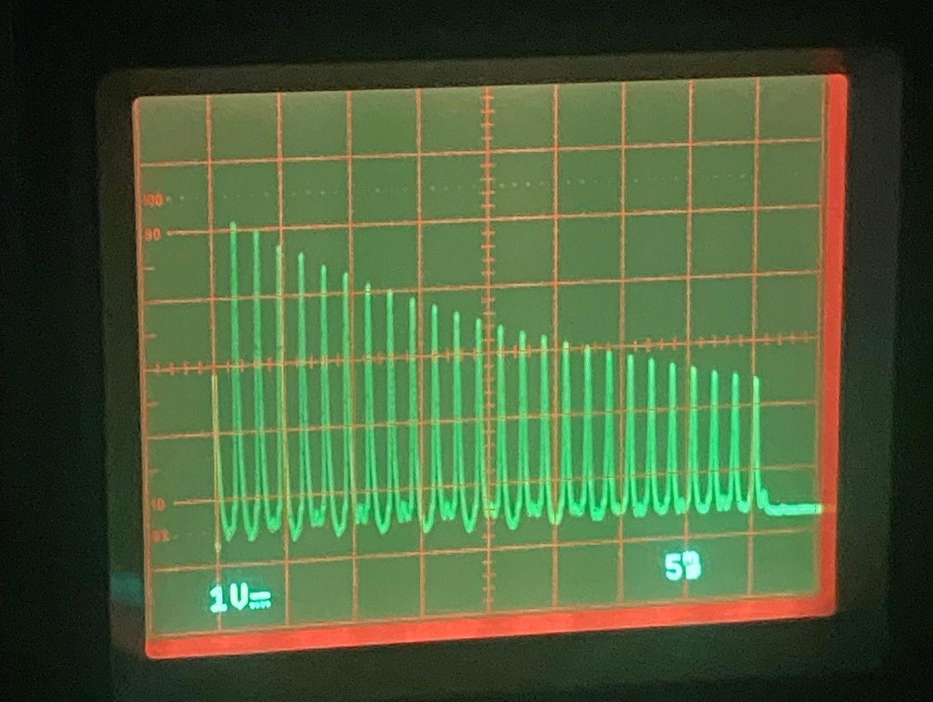
Results and Analysis Cont.
As shown in the previous slide, an echo is produced when the faster and slower spins rephase and dephase.
Assuming the echo is an ideal echo and possesses a lower amplitude than the 90º pulse, there is a clear decay constant being implemented.
The easiest way to then accurately measure the decay constant, T₂, is to either decrease the time between pulses or to have more pulses.
The latter choice was clearly chosen as seen on the right and you can see that T₂ becomes much more easier to graphically calculate in this form.
T₂ is then proportional to this decrease in amplitude with a division of 1V.

Slide 14
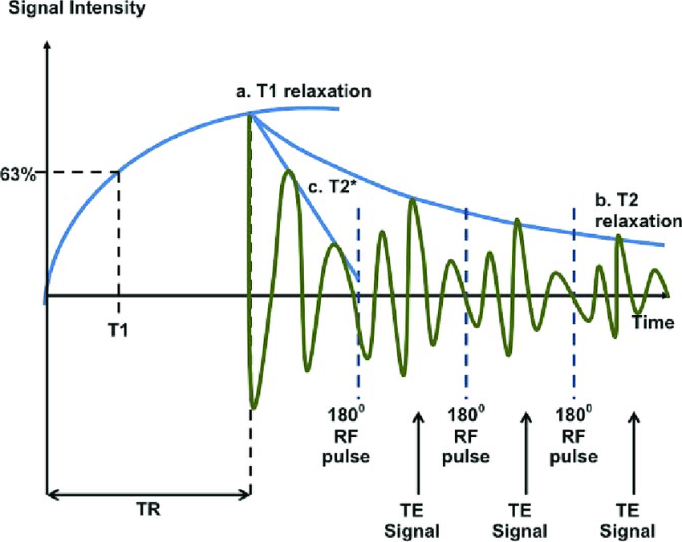
Results and Analysis Cont.
From the given waveforms, the following relaxation times were observed. Here, T₁ represents the spin-lattice relaxation time and T₂ is the spin-spin relaxation time.
T₁= 25 ms +/- 1 ms
T₂= 15 ms +/- 1 ms

Slide 15
Conclusion
To conclude, NMR was successfully observed in the various waveforms that were shown. Resonance was achieved between the pickup probe and the synthesizer frequency, which allowed us to achieve accurate results when the waveforms are in phase. Then, the spin-spin relaxation time, T₂, was observed in three separate waveforms. For the FID waveform, the spin echo waveform, and the multiple echo waveform, the exponential decay was observed. The spin-lattice relaxation time, T₁, can thus be calculated analytically using the equation in slide 5. T₁ is 25 +/- 1 ms and T₂ is 15 +/- 1 ms.

Slide 16
References
Rabi, I.I.; Zacharias, J.R.; Millman, S. & Kusch, P. (1938). "A New Method of Measuring Nuclear Magnetic Moment". Physical Review. 53 (4): 318–327. Bibcode:1938PhRv...53..318R. doi:10.1103/PhysRev.53.318
Filler, Aaron (2009). "The History, Development and Impact of Computed Imaging in Neurological Diagnosis and Neurosurgery: CT, MRI, and DTI". Nature Precedings. doi:10.1038/npre.2009.3267.5.
Hall, L. D. "Nuclear magnetic resonance." Advances in carbohydrate chemistry 19 (1964): 51-93.
Harris, Robin Kingsley. "Nuclear magnetic resonance spectroscopy." (1986).
Young, Ian. "Nuclear magnetic resonance imaging." Electronics and Power 30.3 (1984): 205-210.
Bock, Klaus, and Christian Pedersen. "Carbon-13 nuclear magnetic resonance spectroscopy of monosaccharides." Advances in carbohydrate chemistry and biochemistry. Vol. 41. Academic Press, 1983. 27-66.

